Slide 1
Electric Currents in the Solar Atmosphere
Gregory D. Fleishman
Center for Solar-Terrestrial Research, NJIT
Notes:
1. Structure of the sun and solar atmosphere.
2. First measurements of j at the sun (Severny 1964, 1965).
3. Alfven & Carlqvist (1967) on the role of electric currents.
4. Measurements of j at photosphere and chromosphere. Force-freeness of the field in low-beta chromosphere and corona.
5. Measurements of the j to B misalignment in the chromosphere.
6. Currents in hot plasma. Corona.
7. Estimates of the currents from NLFFF and from MHD modeling.
8. Components of the electric current in hot multi-ion plasma
9. Eigen-modes in the current-carrying plasma
10. Flares & currents; return currents

Slide 2
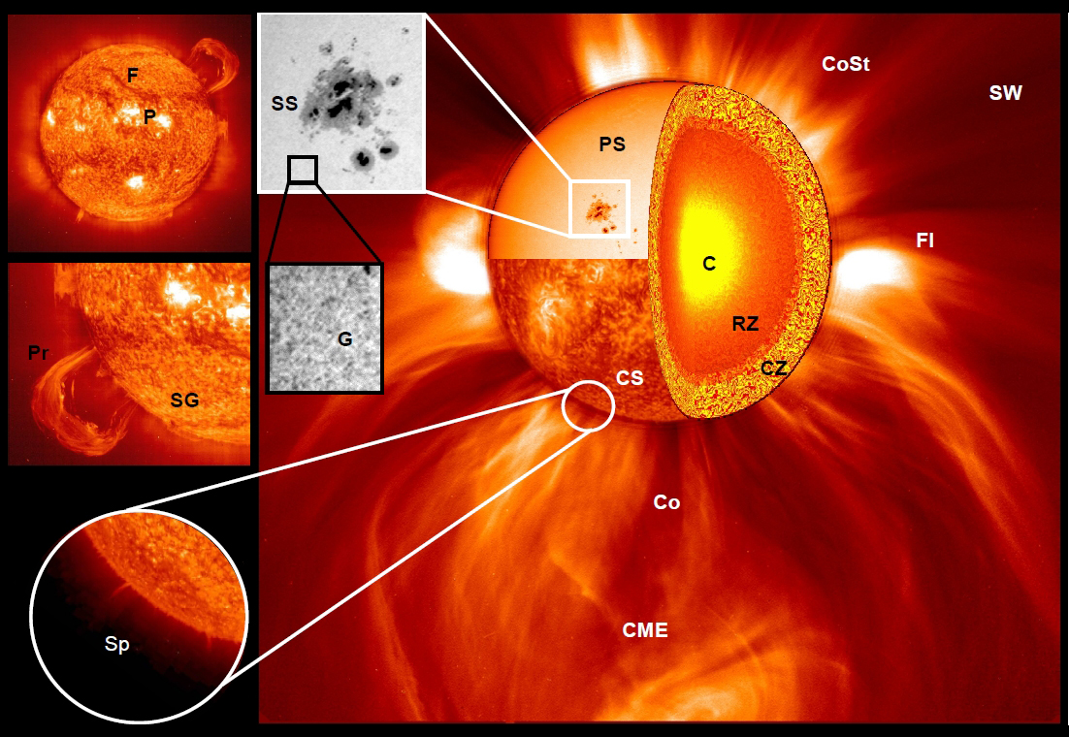
Structure of the Sun and its Atmosphere
Notes:
Core; radiative zone; convection zone => local enhancements of the magnetic field; there is no strong global field: active regions / sunspots.
Sunspot: area with strongest magnetic field, a few kG => dark umbra and filamentary penumbra.
Mention: layer – ph; chr; cor; SW.
Atm. Elements: AR; granulation and supergranulation; bright plage, filaments, spicules, coronal streamers, CMEs, flares
Mention: role of magnetic field in forming these structures and in the energy release in the form of flares and CMEs. Twist of flux tubes reveal the corresponding electric current.

Slide 3
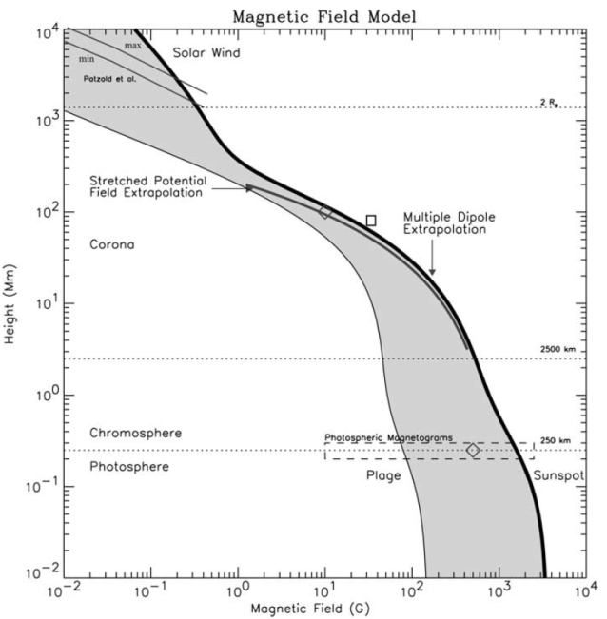
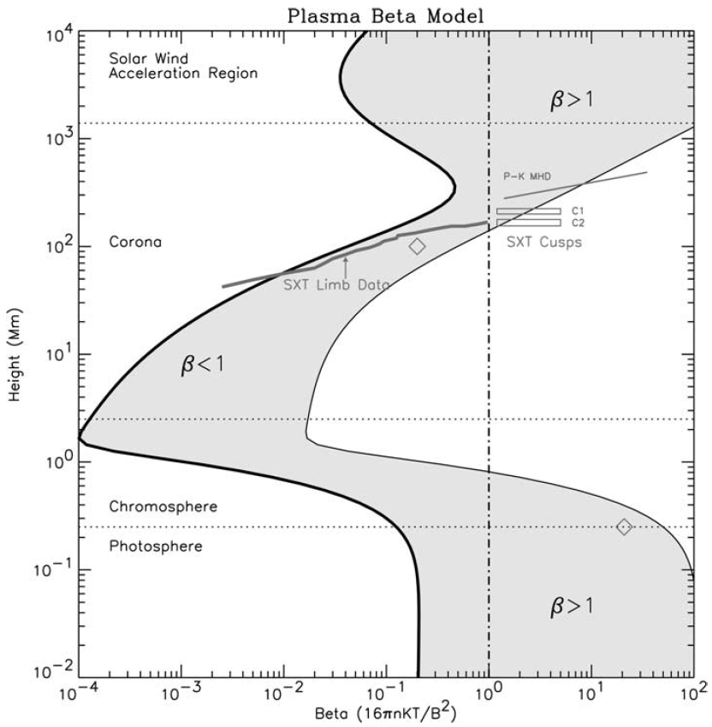
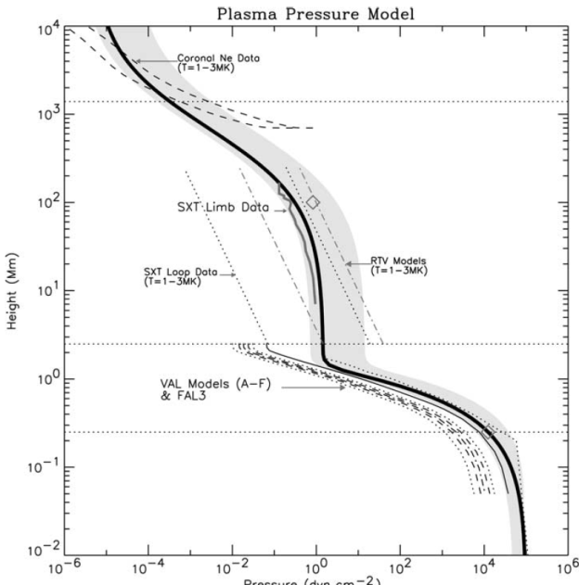
Height distribution of the plasma beta
Gary (2001)
Notes:
Figure 1. Magnetic field model over an active region. The magnetic field intensity as a function of height is shown shaded for open and closed field lines originating between a sunspot of 2500 G and a plage region of 150 G. The photospheric level of 250 km, the chromospheric level of 2500 m, and the coronal level of 2 Rs (2 solar radii) are shown as horizontal dotted lines. The stretched potential field extrapolation is derived by radially stretching the potential field to match the coronal SXT loops (Gary and Alexander, 1999).
Figure 2. Plasma pressure model over an active region as shown by the heavy solid line with a gray shadow. The chromospheric pressure data has been summarized by the use of the VAL and FAL3 models (broken pattern lines). The mid-corona pressure for the model agrees with the derived pressure using Yohkoh/SXT limb data (Gary and Alexander, 1999) (solid short line). Various loop model dependencies are shown for comparison. For comparison, at Rs ∼ 2, two isothermal models (T = 1 and 3 MK) are shown which employ observed coronal electron density (Ne) data. They only roughly influence the derived two-component model. The upper limit of the gray shadow represents pressures of hotter loops.
Figure 3. Plasma beta model over an active region. The plasma beta as a function of height is shown shaded for open and closed field lines originating between a sunspot of 2500 G and a plage region of 150 G. (The plage curve can also represent older, decaying active regions that have no umbral features.). Various data indicate that β approaches unity at relatively low heights in the mid-corona.

Slide 4



Magnetic field or electric current?
“A description in terms of currents is possible, and often physically more interesting than a description in terms of magnetic field.”
Alfven & Carlqvist
Notes:
For quasi-stationary processes, when the displacement current can be neglected, the magnetic field and electric current are linked together such as curl B gives the electric current.
The paper by Alfven & Carlqvist (1967) was inspired by the first measurement of the vertical electric currents at the photospheric level performed by Severny (1964, 1965).

Slide 5
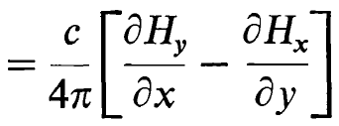

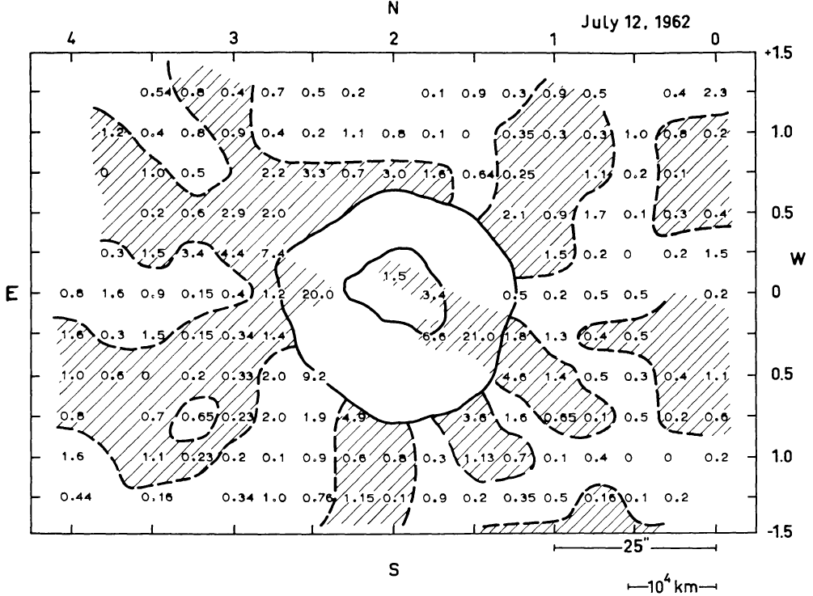
First measurement of j_{z}
Severny 1964, 1965
Notes:
This measurement based on probing the transverse component of the photospheric magnetic field using the linearly polarized components of the Zeeman-split magnetic sensitive optical lines. Here, the open and shaded areas show the positive (up) and negative (down) directions of the electric field.
Nowadays, such measurements are being performed routinely, using space data from Hinode or Solar Dynamic Observatory (SDO).

Slide 6
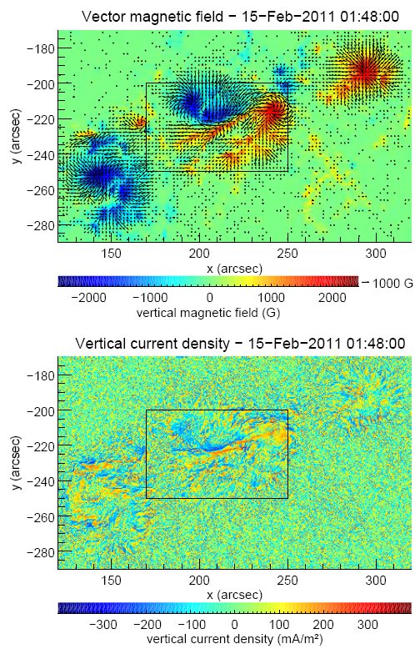
Currently available measurements of j_{z} from SDO/HMI
Musset et al. 2015
Notes:
The magnetic field and electric current density maps are derived from the data of the Helioseismic and Magnetic Imager (HMI) on SDO (Scherrer et al. 2012; Schou et al. 2012). The HMI instrument provides images of the entire Sun in six narrow spectral bands in a single iron line (FeI 617.33 nm) and in four different states of polarization. This
set of 24 images provides spectropolarimetric data to enable the calculation of the full vector magnetic field (inverse problem, ME), at the altitude of formation of the spectral line, which is at the photospheric level in this case. The three components of the photospheric vector magnetic field can be calculated together with the vertical component of the electric current density if the ME inversion is used. The spatial resolution is 0.91 arcsec and one map of the vector magnetic field and of the vertical electric current can be calculated at a 12 minute-time cadence. IQUV data were used for inversion with the Milne-Eddington inversion code UNNOFIT (Bommier et al. 2007).
Fig. 1. Left: vector magnetic field map, right: vertical electric current density map of the active region NOAA AR 11158; produced from HMI data, on February 15 2011 at 01:48:00 UT, and represented in the plane-of-sky. Left: the arrows represent the horizontal component of the field (for horizontal component greater than 100 G), and the colors represent the intensity of the vertical magnetic field (see scale). Right: vertical component of the electric current density (see color scale).

Slide 7
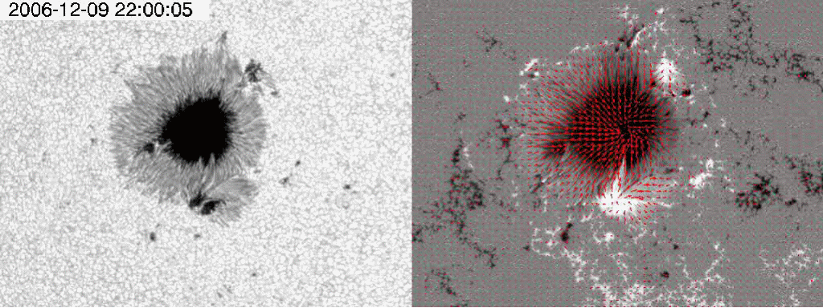
Increase of the electric current - accumulation of the free energy
Benz 2008
Notes:
Left: White light image of a sunspot taken with SOT on board the Hinode satellite. The resolution is 2”. Visualization by Hinode scientists. Right: Vector magnetogram showing in red the direction of the magnetic field and its strength (length of the bar). The movie shows the evolution in the photospheric fields that has led to an X class flare in the lower part of the active region.
Photospheric observations clearly support the scenario that flare energy originates from free magnetic energy in excess of the potential value (defined by the photospheric boundary) or, equivalently, from electric currents in the corona. For a rapid release, the currents must be concentrated into small regions.

Slide 8
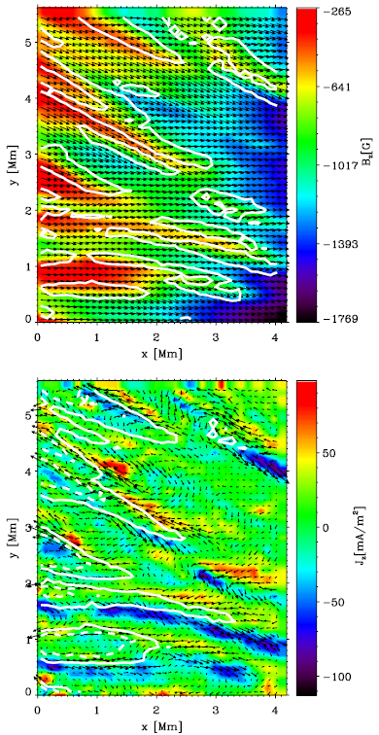
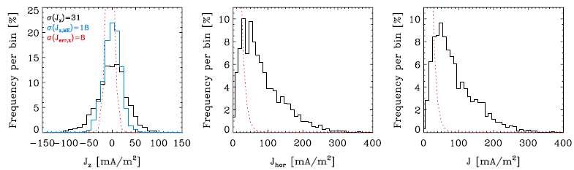
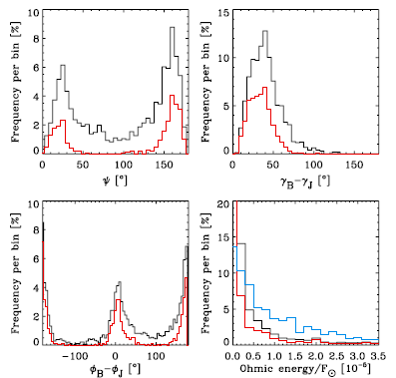
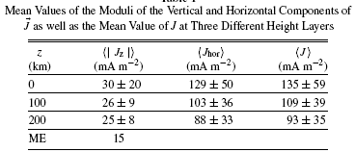
3D picture at the photosphere
Puschmann et al. 2010
Notes:
To obtain a 3D picture of electric currents at the photospheric level, Puschmann et al. (2010) used a more advanced, than ME, inversion based on a 3D geometrical model of a section of the inner penumbra of a sunspot. Stating somewhat simplistically, the authors took into account the fact that a spectral line is formed in a finite layer, rather than from a surface. This approach yields very interesting results summarized in this slide.
Figure 1. Upper panel: Bz (in color) and Bhor (arrows) at z = 200 km. The size of the arrows ranges from 1220 to 1900 G. The contour lines enclose areas with J > 120 mA m⁻². Lower panel: Jz (in color) and Jhor (arrows) at z = 200 km. The size of the arrows ranges from 1 to 365 mA m⁻². The contour lines correspond to Bz equal to −650 G (solid lines) and to −450 G (dashed lines).
Figure 2. Left panel: histogram of Jz at 200 km (black) and histogram of Jz retrieved from a Milne–Eddington inversion (blue). Middle and right panels: histograms of Jhor and J evaluated at the same height layer. The red lines represent the corresponding error distributions.
Figure 3. Upper left panel: histogram of the angle ψ between J and B at z =0 km. Upper right panel: histogram of the difference between the inclination from the vertical of B and J at z = 0 km. Lower left panel: the same for the difference in azimuth. Lower right panel: energy dissipated by electrical currents in units of 10⁻⁵ solar flux (between 0 and 200 km, black, between −225 and 200 km, blue). In all the panels, the red line corresponds to angles and energies evaluated for those pixels with J (z = 200) > 120 mA m⁻².

Slide 9
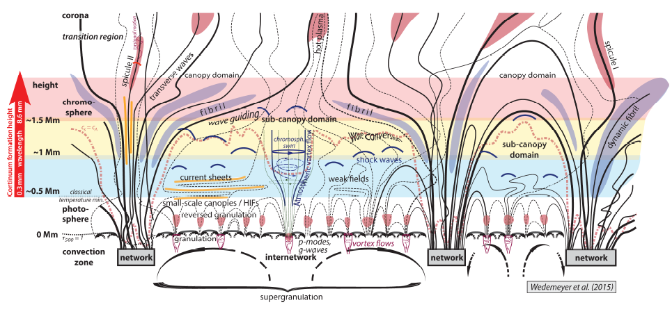
Chromosphere
Notes:
Fig. 8 Schematic structure of Quiet Sun regions. This illustration is based on the cartoon by Wedemeyer-B¨ohm et al. (2009) but has been updated and now contains vortex flows and torsional motions. The horizontally aligned colored areas represent the layers which are mapped by ALMA.

Slide 10
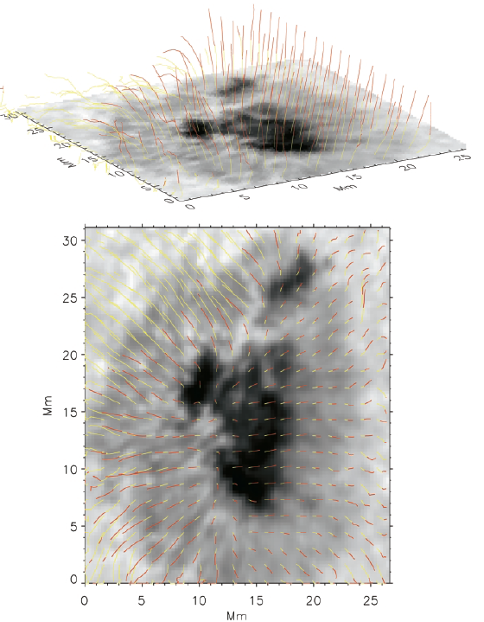
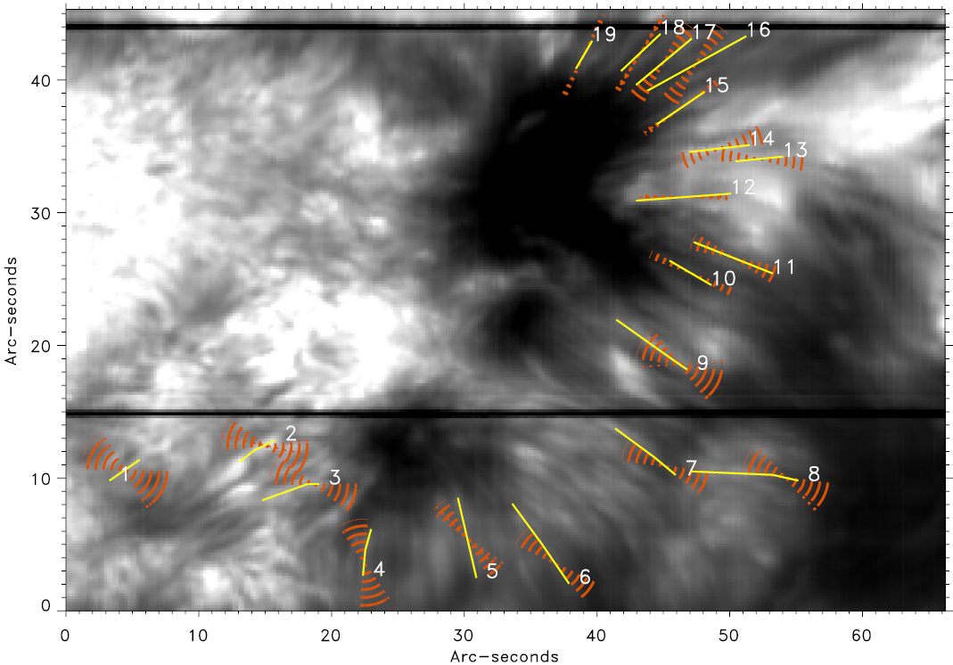
3D picture at the chromosphere
de la Cruz Rodríguez and Socas-Navarro (2011)
Chromospheric Hα fibrils vs transverse magnetic field: they are not aligned in the general case.
3D picture of the magnetic field at ph-to-chr levels
Socas-Navarro (2005)
Notes:
Chromospheric probing of the magnetic field is based on magnetic-sensitive lines (Ca II 8542 A or He 10830 A). Their inversions are much more complicated that those at the photospheric level, because they has to take into account the non-LTE effects.
The non-LTE inversions are very computing-intensive. However, this kind of analysis is necessary for accurate vector magnetometry (Lites et al. 1994; Socas-Navarro 2002) because radiative transfer and magneto-optical effects give rise to very complex dependences of the observables on the atmospheric conditions. The detailed analysis produced a three-dimensional reconstruction of the full magnetic field vector in the active region. Figure 1 shows the magnetic structure in the large sunspot, after deprojecting it to disk center and with the magnetic field transformed to the solar reference frame.
Fig. Left.—Three-dimensional structure of the magnetic field lines. Top, perspective view; bottom, view from above. The height range between 0 km and 800 km is represented in yellow, whereas the range between 800 km and 1600 km is in red. Axes are in megameters. Only field lines originating on a 5#5 pixel grid are shown in the bottom panel (5#10 in the top panel), to avoid cluttering the figure.
Figure Right shows the chromospheric field of view observed with SPINOR in a grayscale image. Superimposed on that image, yellow lines indicate the fibril segments that have been manually selected for analysis based not only on the appearance of the fibrils but also on the presence of linear polarization. The Stokes profiles inside the band defined by each segment and a width of 3 pixels were averaged to produce one low-noise set of Stokes profiles for each fibril.
Having the three-dimensional structure of the vector magnetic field, one can compute the vector current density as the curl of the field.
Fig. 1, cont: The 180 ambiguity in the (observer’s frame) azimuth was resolved by picking the value that resulted in a more radial field when converted to the solar coordinate frame. As a consistency test, the divergence of the field across the entire map
using boxes of 1.6 Mm in each dimension was computed. It was found that the divergence is always small compared with B/l (the magnitude of the field divided by the length of the box), with an average absolute value of 1.8%. This argument, as well as the spatial coherence of the results obtained (recall that each pixel was inverted independently), strongly supports the reliability of the results.
Fig. Right. Field of view observed with SPINOR in the core of Ca ii 8542 Å. Yellow lines: fibrils selected for analysis. Red cones: range of magnetic-field azimuth compatible with the Q and U profiles. The spatial sampling is 0.22/pixel.
The yellow segments define the direction of the three-pixel wide bands used for Stokes Q and U profile averaging.

Slide 11
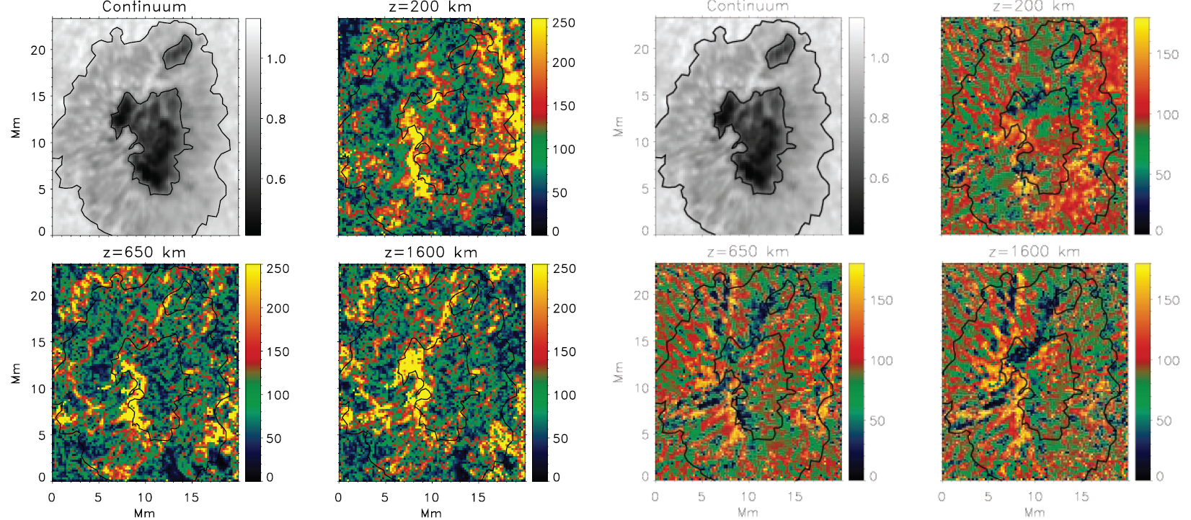
J to B misalignment
(a) Top left: Continuum image of the sunspot analyzed in this work (in units of the average quiet Sun). The rest of the panels present current density maps (units are
mA /m²) at z = 200, 650, and 1600 km.
(b) Top left: The same continuum image. The rest of the panels present the angles (degrees) between the vector current and the magnetic field.
Socas-Navarro (2005)
Notes:
Having the three-dimensional structure of the vector magnetic field, one can compute the vector current density as the curl of the field.
Figure 1a shows maps of the current density at different heights in the atmosphere. The strongest currents are organized in filamentary structures, at least when viewed in these two-dimensional representations (horizontal cuts). In three dimensions, their appearance is more reminiscent of “sheets.” The western boundary of the sunspot (right of the images) exhibits a very prominent system of strong currents, especially in the photosphere. These currents are not aligned with the vector field, which implies that the field is “forced” (i.e., non–force-free).
Figure 1b shows the angle between the currents and the magnetic field lines. In a force-free field, this angle would be either 0 (parallel) or 180 (antiparallel) everywhere. We can see that as one would expect, the field is more force-free in the chromosphere than in the photosphere. However, even the higher chromosphere is far from being entirely force-free. Only the inner part of the eastern penumbra is fairly force-free and exhibits a pattern of alternating parallel/antiparallel field-aligned currents running along the penumbral filaments. The filamentary structure extends outward, even beyond the limit of the visible penumbra, but with significant inclinations with respect to the field lines. The same pattern of incoming/outgoing non–field-aligned currents is visible in the northeast (top left) quadrant of the photospheric penumbra.
The magnetic topology in the area surrounding the spot is very different on both sides of it: while the east side is almost devoid of strong flux, the west side harbors a very intricate pattern of strong magnetic fields.
It is interesting to note that Ha images of this active region show considerable activity on the west side very near the sunspot. Moreover, we identified two Ellerman bombs (Socas- Navarro et al. 2005b) located off of the edge of the western penumbra. The combination of Ha emission, Ellerman bombs, and complex field topology is a symptom of ongoing magnetic reconnection, which is consistent with the presence of strong currents such as those shown in the figure.

Slide 12
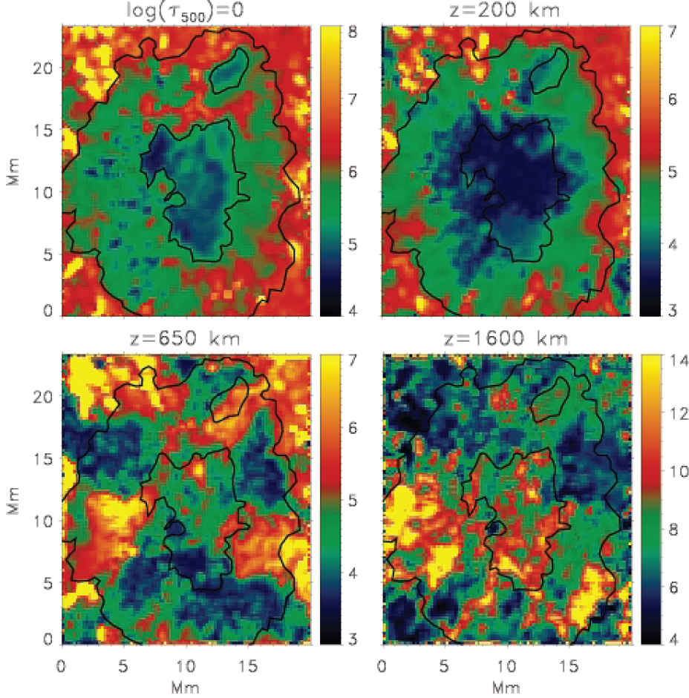
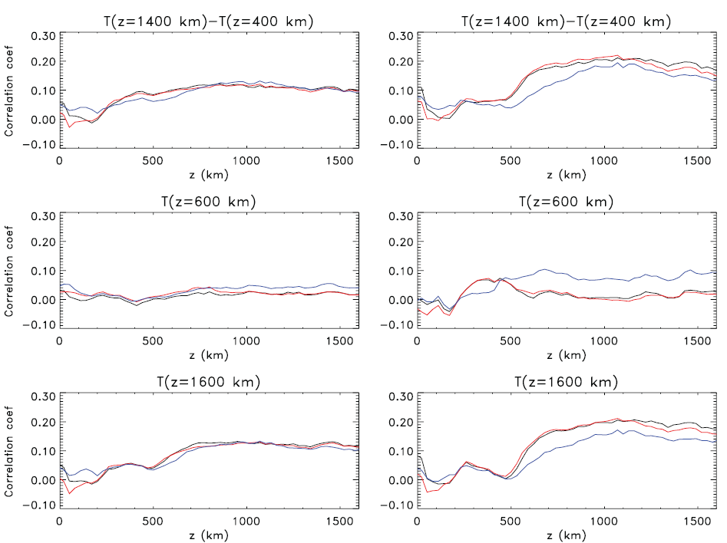
Role of J in chromosphere heating
Pearson’s correlation coefficient between the spatial distribution of temperatures at the geometrical height indicated by the label of each plot and the current densities at height z. The left panels include the entire data set, whereas the right panels are restricted to the sunspot penumbra only.
Temperature maps (kK) at different heights in the atmosphere: at the photosphere and at geometrical heights 200, 650, and 1600 km, respectively.
Socas-Navarro (2005)
Notes:
Let us now turn to the thermal structure of the sunspot, which is a complementary outcome of the line inversion, and its relation to electric currents. Figure (left) shows horizontal cuts of the electron temperature at several heights. We can see that the chromosphere exhibits “hot patches,” with typical size scales of ∼5 Mm, embedded in a cooler medium. When this figure is compared to the current density maps from the previous slide, we can see that they are fundamentally different, and there is no obvious connection between chromospheric hot spots and the strong current sheets. A more quantitative analysis is presented in Figure on the right, which shows the spatial correlation between currents and temperatures. Notice that, even though the overall correlations are very weak, they are nearly always positive. This is an indication that current dissipation might indeed be contributing to the chromospheric heating above sunspots, but it is not the dominant mechanism. The correlation coefficient increases by about a factor of 2 (but still remains weak) if we restrict the analysis to the penumbral region (right panels), suggesting that the effect of electric currents is more important in the penumbra. It has been proposed (see, e.g., Goodman 2004) that only the component that is perpendicular to the field (the so-called Pedersen currents) is relevant for the heating of the upper atmosphere. The correlation curves for the entire region (left panels) do not generally show a clear distinction between both components. However, the penumbra (right panels) exhibits a slightly better correlation with the Pedersen component, in agreement with that statement.
In the right panels. The black line represents the modulus of the vector current density, whereas the red and blue lines represent the components perpendicular and parallel to the field, respectively. The upper panels refer to the temperature gradient between the upper photosphere and the chromosphere. Under strict radiative equilibrium conditions, this gradient should be slightly negative, and the temperature would decrease monotonically with height. Therefore, the patches with positive temperature gradient are regions with important heating activity. The middle and lower panels depict the correlations between currents and temperatures at the lower and upper chromosphere, respectively.

Slide 13
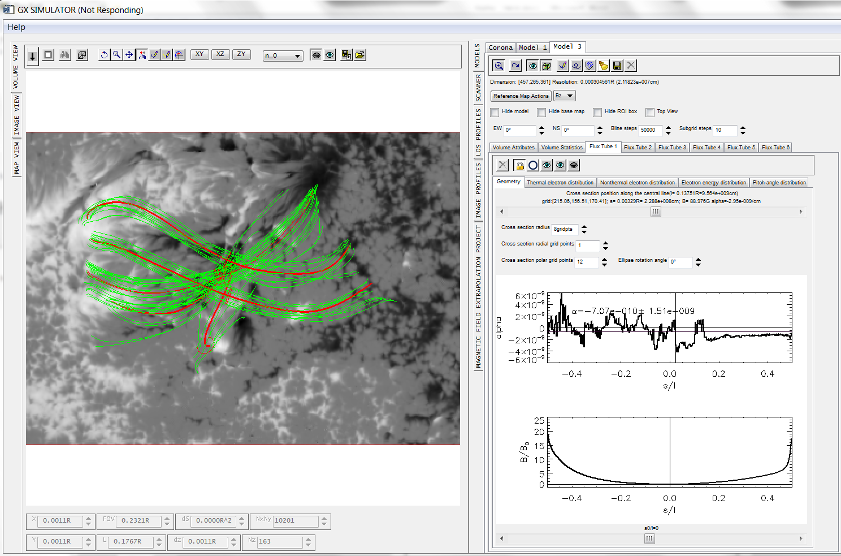
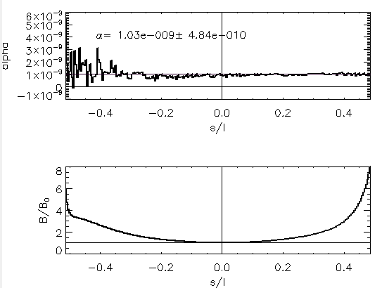
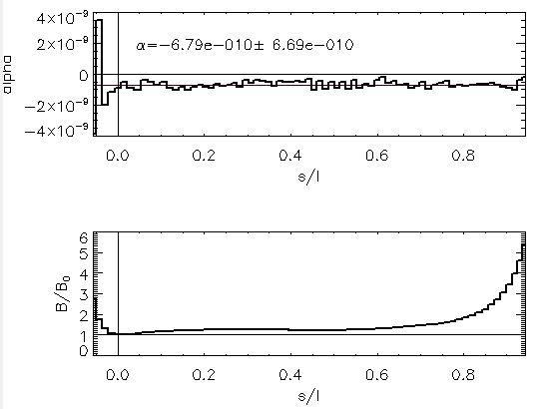
Corona: use of nonlinear force-free field extrapolations
Notes:
There is no diagnostics to derive the magnetic field vector in the corona. Thus, the information on the magnetic field and electric current vectors in the corona is derived from static (NLFFF) or dynamic (MHD) modeling augmented by one or another coronal diagnostics in some cases. Low-beta; force-free field, field-aligned currents, alpha variation along the model field lines.

Slide 14
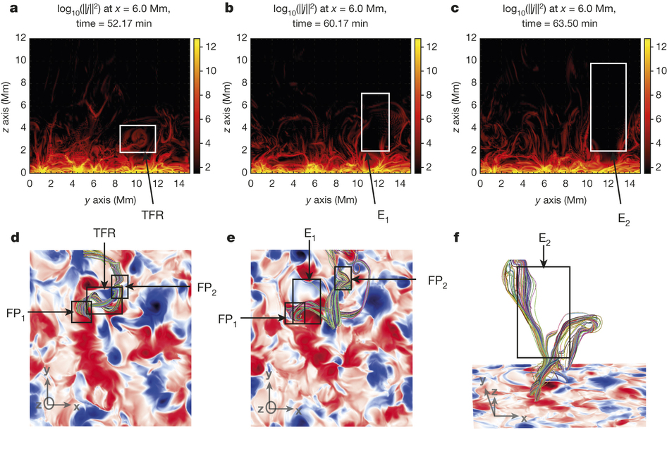
Corona: MHD modeling
Twisted flux rope eruption.
a–c, Vertical cuts at constant x of the logarithm of the square of the modulus of the electric current density (nondimensional units).
a, The TFR section (boxed) clearly shows that its eruption is associated with opening of the configuration, with current layers structuring the atmosphere at those heights and above (Video).
d–f, Selected field lines showing the evolution of the TFR. The
background image represents the vertical component of the magnetic field at z = 1,500 km, which appears to be organized in stronger ‘spots’ and can reach locally 30 G.
d, e, The chromospheric trace of the TFR is associated with footpoints FP1 and FP2. Flux changes occur at its chromospheric ‘feet’ FP2 as seen from d to e. They imply topological constraints leading to the eruption of the TFR shown at two particular times in boxes E1 and E2 drawn in e and f, respectively.
Amari et al. (2015)
Notes:
http://www.nature.com/nature/journal/v522/n7555/full/nature14478.html#videos
The magnetic structures emerge with strong twist and shear, and later on suffer additional deformations driven by the surface velocity field. Intense electric currents flow across the magnetic lines and along them, with the parameter α (measuring the ratio of the parallel electric current to the magnetic field strength) being maximal in the chromosphere. In particular, as clearly seen in the lowest parts of Fig. a–c and the Video, electric currents strongly concentrate near the separatrices, which appear as current sheets. Because of the presence of all these currents, the magnetic energy is far above the energy of the associated current-free magnetic configuration, which has the smallest magnetic energy compatible with the flux distribution on the photospheric boundary.

Slide 15



J: components
E

Slide 16


J: multi-component (hot) plasma
E

Slide 17

Bulk velocities of various components
Balance of Forces Reads:

Slide 18
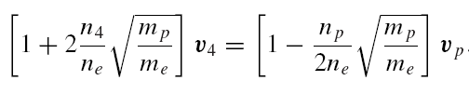






Example: Helium ions ⁴He & ³He
2.9x10⁻³
1. Protons move much faster than in a purely hydrogen plasma.
2. Helium ions move at the SAME direction as ELECTRONS, and oppositely to PROTONS!!
3. ³He ions move much faster than ⁴He ions
>>
in e-p plasma
5x10⁻⁴
8.8x10⁻³
5.7
5x10⁻²

Slide 19

E
Gurevich 1961; Furth & Rutherford 1972, and Holman 1995

Slide 20
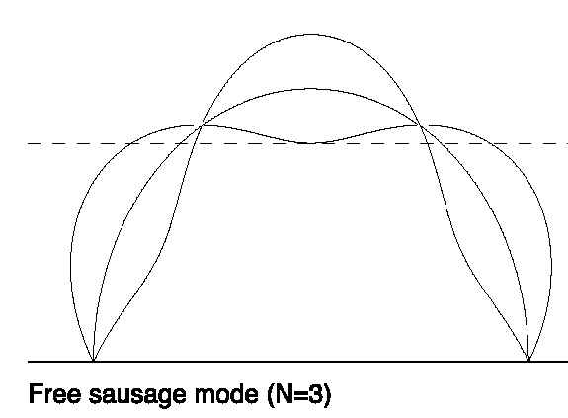
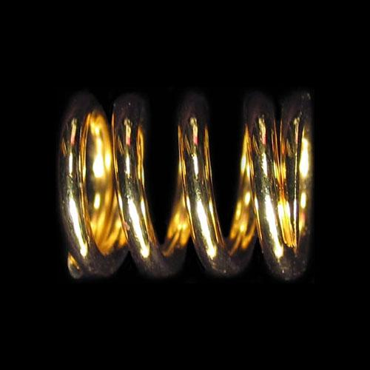
Alfven wave on top of current-carrying magnetic field

Slide 21






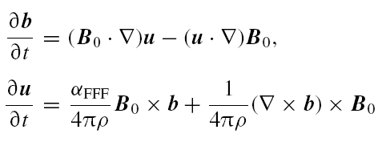

Eigen-modes in the presence of electric current

Slide 22







Modifications to Alfven wave
Vectors u and b are not parallel to each other
Nonzero kinetic helicity:
Nonzero mean
electric field:
Direction of this electric field does NOT depend on the k-vector, but on B-vector only: E rises as the turbulence energy <b²> goes up
Fleishman & Toptygin (2013)

Slide 23
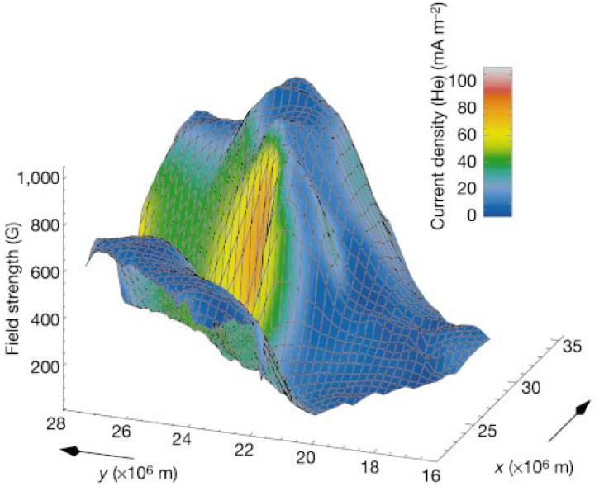
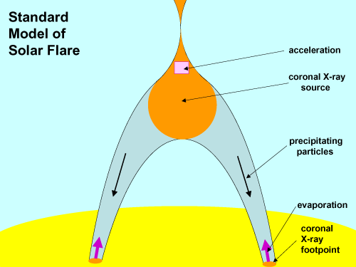


Electric current & solar flares
Solanki et al. (2003)
Benz (2008)
Notes:
For a rapid release, the currents must be concentrated into small regions. Such currents may be inferred observationally in regions with a tangential discontinuity of the magnetic field direction in the system of rising loops near the base of the corona (Solanki et al., 2003).

Slide 24
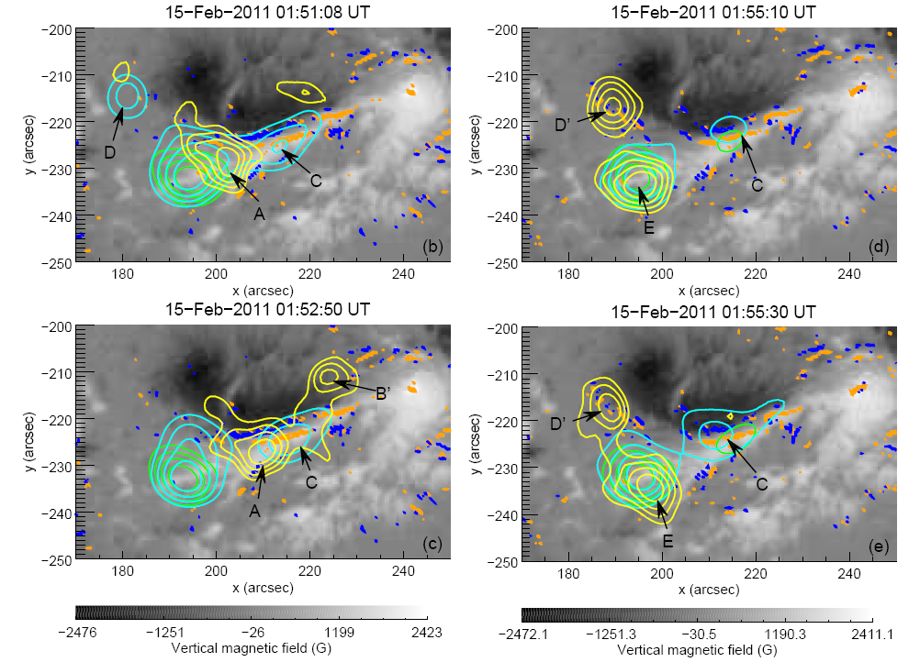
Association between X-ray emission and photospheric currents.
Musset et al. (2015)
Notes:
Part of the elongated thermal and non-thermal X-ray sources (observed at energies below 50 keV) are located above the narrow and elongated current ribbons measured at the photospheric layer. These elongated X-ray structures have furthermore been identified as being produced in the corona by electrons injected from an extended acceleration region located close to the apex of the magnetic structures. At energies above 50 keV, the X-ray source A is furthermore located very close (in projection) to the main current ribbon (shown by a black arrow in the top panel of Figure 7) revealing the close association between the location of the acceleration region and the location of the electric current sheets.
As it has been discussed in Janvier et al. (2014), the photospheric current ribbons (closely related to the flare EUV ribbons) are the tracers at the photospheric boundary of the electric current sheets present in the coronal volume. These current layers are themselves formed in regions of strong gradients of magnetic connectivity known to be the preferred locations where reconnection can occur (see e.g. Demoulin et al. 1996). As a consequence, plasma heating and particle acceleration can be produced in these regions. This explains why part of the thermal and non-thermal X-ray emissions produced in the coronal elongated sources are found above the photospheric current ribbons which trace the footprints of the coronal current layers.
At energies above 50 keV, the apparition of the X-ray source D’ is accompanied with the appearance of cospatial photospheric currents in the same time interval. Note that the observation of the current density evolution has to be carefully examined since polarization measurements during flares can be biaised, and some of the observed features could result from polarization artifacts due to impact of non-thermal particle beams (see Henoux & Karlicky 2013, and references therein) or induced by resonant scattering
due to radiation anisotropies at the edges of flare ribbons (Štěpan & Heinzel 2013). Janvier et al. (2014) discussed this issue for this specific event. They analyzed cautiously
the vector magnetic field in the active region and concluded that the changes in the electric current density are not artifacts due to polarization effects. They argue that the horizontal fields (from which vertical electric currents are derived) are consistent in both maps at 01:36 UT and 02:00 UT with a signal free of artifacts given the smooth rotation of the magnetic field in this region.

Slide 25
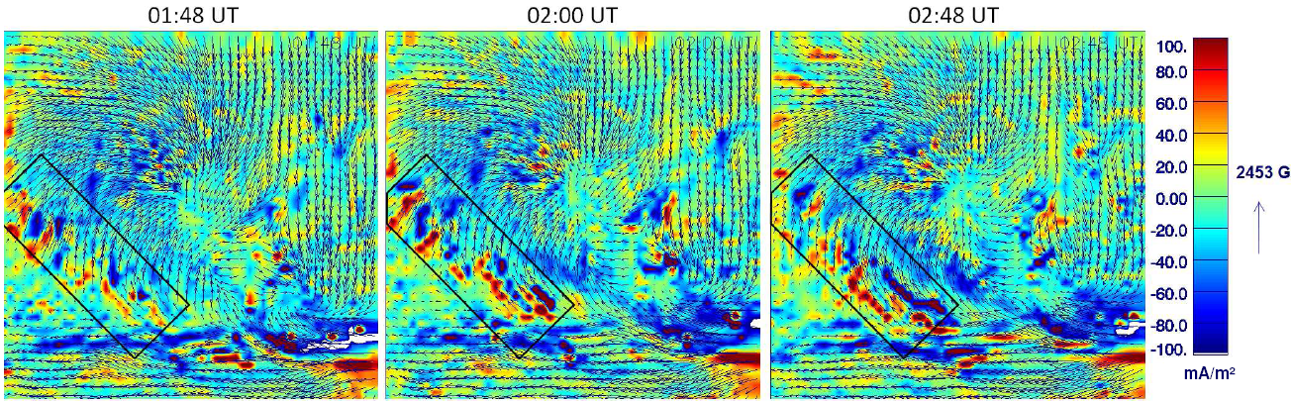
Evolution of the photospheric current at the course of flare
Musset et al. (2015)
Notes:
This figure clearly shows a coherent direction of the horizontal magnetic field which varies smoothly within the field of view. Moreover, the curvature of the horizontal field lines increases between 01:48 and 02:00 UT, which is responsible for the increase of the observed vertical current (see also the observations by Petrie 2013). The increase of the photospheric currents in the black box of the figure is not due to a polarization artifact but reflects real changes in the horizontal magnetic field and is thus real. As a conclusion, the appearance of the new HXR source D’ and the increase in the same region and in the same time interval of the photospheric currents are linked. The increase in the photospheric currents can be interpreted as a response at the photospheric layer of the change of magnetic topology and current systems in the corona induced by reconnection (see Janvier et al. 2014). As particle acceleration is also a consequence of the magnetic reconnection in the corona, it naturally explains the close temporal and
spatial association between locally enhanced X-ray emission and increase in the same region and at the same time of photospheric currents: both result from the same phenomenon, namely magnetic reconnection in the localized coronal current sheets. It should finally be noted that such a related evolution of X-ray sources and electric currents in the course of a flare has not been reported previously, given the low cadence of magnetic field measurements before SDO/HMI. However, even in the present case, it is clear that the cadence to derive magnetic field maps (and current density maps) from HMI (12 minutes) is still too low to be able to track the evolution of electric currents on the time scales relevant to the evolution of X-ray sources (a few tens of seconds).

Slide 26
Summary
“A description in terms of currents is possible, and often physically more interesting than a description in terms of magnetic field.” ???
Considering the electric current in addition to the magnetic field is essential to address many fundamental physical problems!!!

